Slide 1
School e-Learning Management System
SHUJA ALI
Email: itsshuja1997@gmail.com
Location: Garden East , Karachi
Cell number: +92-334-3937237

Slide 2
Background
Mohammed Ramzan, who works as a mason at a construction company in Dubai, said that he would be one of the first to try the e-learning project.
“I had to leave school at the age of 11 when my father died and there was no one in the family to feed us,” he said. “My mother took me out of school and sent me to the nearby construction site in Lahore to earn money. Since then, I haven’t seen school. It was my father’s dream for me to become an engineer so that I could create big buildings.
“Unfortunately, I was not able to achieve his dream, but if I get the chance, I will surely complete my education.”
Mr Ramzan said he has a smartphone, which will help him to connect with e-classes.
“If I can watch films, do video calls from my mobile then I can also take classes as well. Thanks to the technology,” said the 32-year-old Pakistani.

Slide 3
E-learning
An online educational or e-learning service is which teaches and helps students improve in subjects such as Math's , English and Science.
These are normally used by schools to let students learn at home and complete homework online.

Slide 4
Benefit to the children of Pakistan
We [the Pakistani community] need educational access for our children at an affordable cost. The e-learning enable students to complete their discontinued education,” (Samina Nasir).
About 20,000 Pakistani children in the UAE are sitting at home without an education because their parents cannot afford the fees of private schools and community Pakistani schools are full (Nasir).
Children can get knowledge when at distance from the class without help of teachers.

Slide 5
Continued…
With the inception of the e-learn app, students living in far off and backward areas where many students are out of schools due to financial and other reasons while still, qualified teachers are not available in remote areas can get access to the lectures.
Online learning could help us regain that lost footing as well as bridge the gap between public and private education.

Slide 6
Benefits to school for adopting e-learning
Online Learning Accommodates Everyone’s Needs
Lectures Can Be Taken Any Number Of Times
Offers Access To Updated Content
Quick Delivery Of Lessons
Scalability
Consistency
Reduced Costs
Effectiveness
Less Impact On Environment

Slide 7
BENEFITS FOR THE TEACHERS
The load on single teacher teaching all subjects and taking classes for all subjects is reduced drastically.
Quality lectures are provided to all the students.
Teachers who are themselves lagging in the knowledge of subjects get a chance to improve their skill-set by learning from the best.
The government can keep a quality check on the course material produced in the capital city of their state by ensuring courses produced are not only through experience teachers but are also developed with a right mix of visual experience to help students better relate to them.

Slide 8
Benefits for school going children
Quicker access to the lectures
A systematic way of learning
Tutor free can be save
In 2010, an experiment was performed on two groups of children; the first group was made to watch a video on how to build a particular object, while the other was presented with live demonstration. The result was that the second group performed the task better.
Another study conducted in 2014 also found that children learn 22 times better from real-world 3D objects with their parents actively involved, rather than touching screens.

Slide 9
Obstacles face by administration and teachers
Knowledge about online technologies and programs
Support from administrators
Access to technologies
Time, financial support, and parental support
Materials
Support from higher education
Teachers’ beliefs and practices.

Slide 10
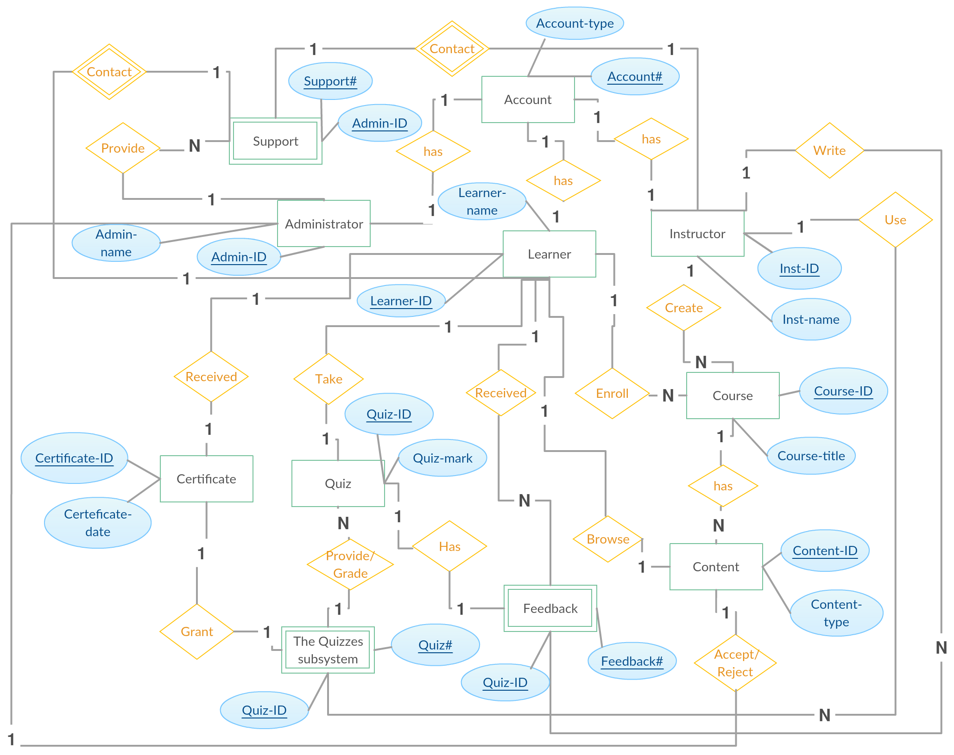
ERD

Slide 11
References
[1]. https://www.dawn.com/news/1281161
[2]. https://www.morenews.pk/e-learn-app-pakistani-students-get-rid-tuition/
[3]. https://www.thenational.ae/uae/uneducated-children-to-benefit-from-e-learning-programme-1.71770
[4]. https://elearningindustry.com/9-benefits-of-elearning-for-students
[5]. https://simple.wikipedia.org/wiki/E-learning
[6]. https://www.nap.edu/read/11995/chapter/4#18

